Slide 1
T.Y.BSc.
NUCLEAR CHEMISTRY

Slide 2
Nuclear Activity
The nucleus does not strongly aﬀect the chemistry of the atom (bond making/ breaking).
HOWEVER, the nucleus can undergo changes, which usually cause an element to change into another element.

Slide 3
Implications of Nuclear Activity for Humans
Hazardous eﬀects of radiation
Medical applications of radioactivity
Dating by radioactivity
Nuclear energy
Nuclear weapons

Slide 4
Radioactivity

Slide 5
Radioactivity (Radioactive Decay)
Radioactivity: the spontaneous decomposition of atomic nuclei, which releases high-energy particles or rays
Radioactive decay results in a diﬀerent nucleus.
Nuclide: a nucleus with a specified number of protons and neutrons (= a specific isotope)

Slide 6
Isotope Symbol
Mass Number (number of protons + neutrons
A _{X}
Element Symbol
Z
Atomic Number (number of protons) Identifies element
Similar notation for subatomic particles
1 _{p}
1_{n}
0 _{e}
Proton
Neutron
Electron
1
0
−1

Slide 7
Radioactivity
Every element has at least one isotope whose nucleus spontaneously decomposes (radioisotope).
A certain level of radiation naturally occurs all around us, even in our bodies (potassium-40).

Slide 8
Nuclear Equations
In a balanced nuclear equation, both the atomic number and the mass number must be conserved.

Slide 9
Types of Radioactivity
1. Alpha Particle (α) Emission
α particle = helium nucleus
Net eﬀect: loss of 4 in mass number, loss of 2 in atomic number

Slide 10
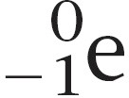
2. Beta Particle (β) Emission
Types of Radioactivity
β particle: an electron
Net eﬀect: A neutron is changed into a proton.
0 _{e}
1 1
0
n → p +
1
−1

Slide 11
Types of Radioactivity
3. Gamma Ray (γ) Emission
Gamma ray: high-energy photon of light (no charge or mass)
Often accompanies diﬀerent types of nuclear decays
Net eﬀect: no change in mass or atomic number

Slide 12
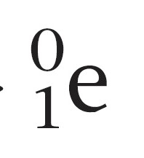
4. Positron Emission
Types of Radioactivity
Positron (β⁺): a particle with same mass as electron but opposite charge
Net eﬀect: A proton is changed into a neutron.
1 1
1
0
p → n + e
0
1

Slide 13
Types of Radioactivity
Electron Capture
One of the inner-orbital electrons is captured by the nucleus.
Net result: Changes proton into neutron.
A way to make gold? Impractical

Slide 14
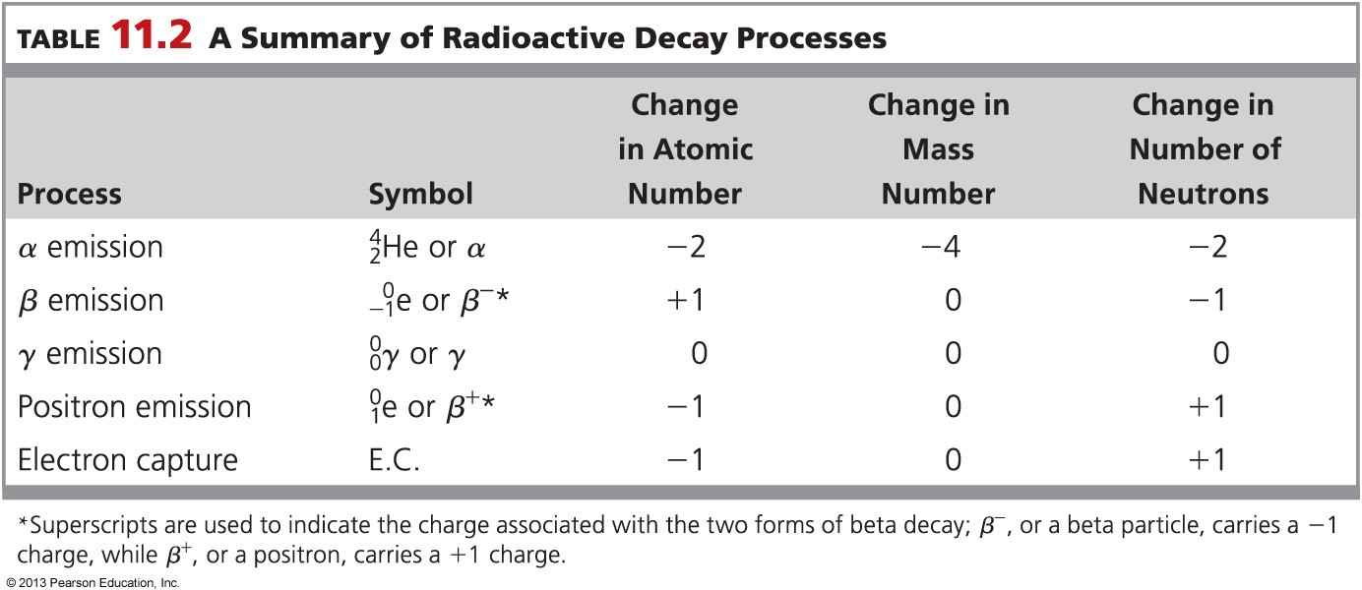
Summary: Radioactivity
Ex Probs

Slide 15
Nuclear Transmutation
Nuclear transmutation: the change of one element into another by particle bombardment (neutron, α particle, proton, nucleus)
Most of the ~3300 known radioisotopes are made through artificial nuclear transmutation in particle accelerators.
14
7
N +
1
0
n →
14
6
C +
1
1
H
238
92
U +
4
2
He →
241
94
Pu +
1
0
n

Slide 16
Nuclear Transformation, cont’d
All elements with atomic numbers greater than 92 (transuranium elements) have been artificially made.

Slide 17
Half Life

Slide 18
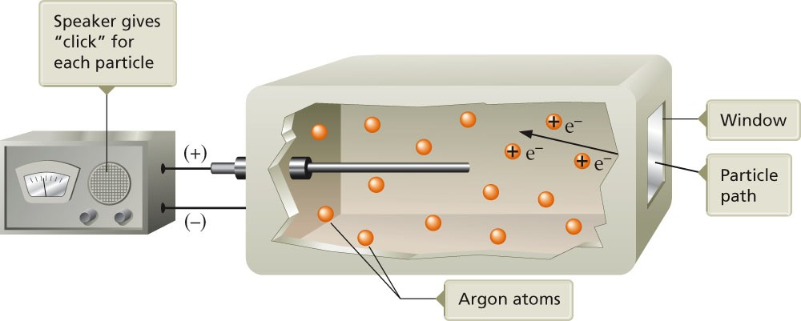
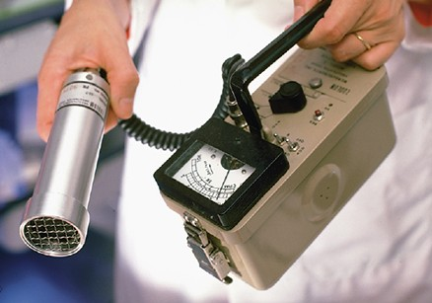
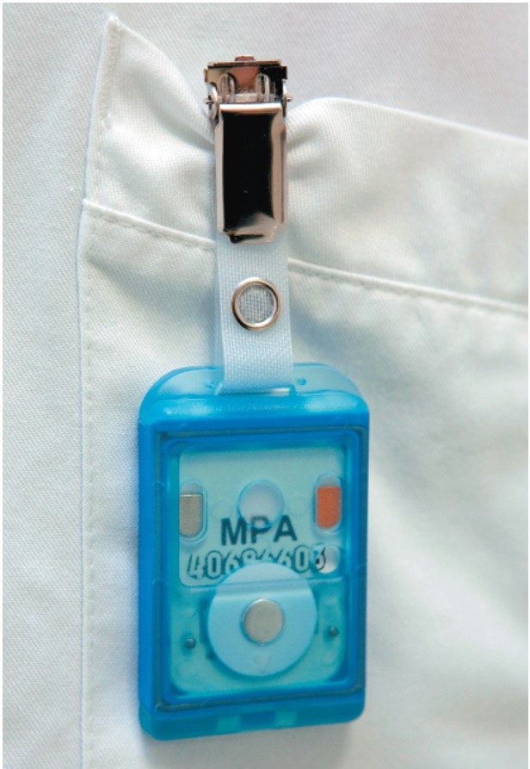
Detection of Radioactivity
Geiger-Müller counter: High-energy particles ionize argon; argon ions can conduct electricity
Scintillation counter: Uses a substance that gives oﬀ light when struck by high-energy particles
Thermoluminescent dosimeters: Electrons excited by high-energy particles are trapped in crystals, then heated to relax into ground state and emit light

Slide 19
Half-life: Time required for half of the original sample of nuclei to decay
Half-Life
1 min 1 min
220
86
220 _{Rn}
220 _{Rn}
1 mil
Rn
1/2 mil
1/4 mil
86
86
4.5 bil yrs
4.5 bil yrs
238_{U}
238_{U}
1 mil
1/2 mil
238
1/4 mil
92
92^{U}
92

Slide 20
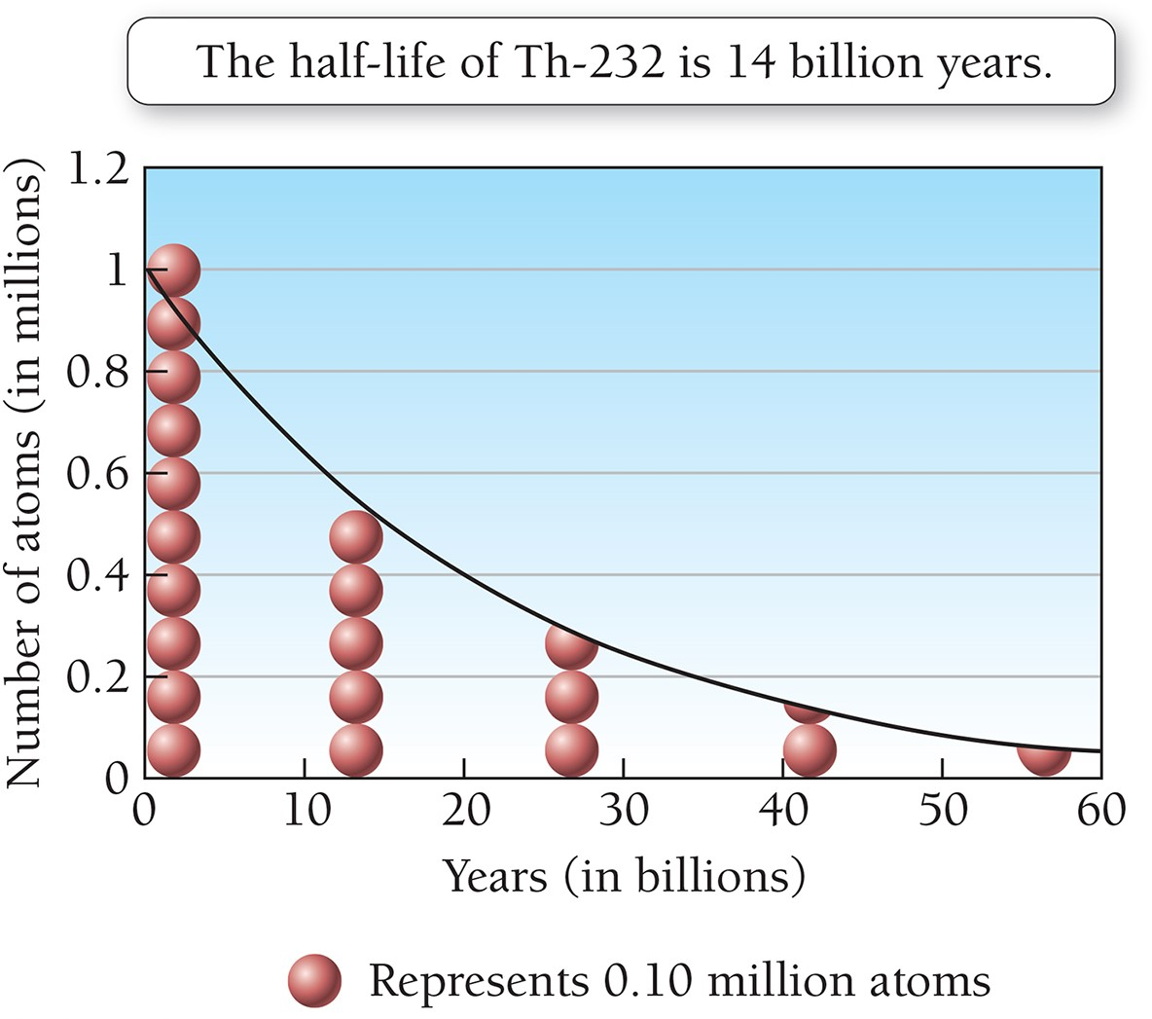
Half Life of Th-232

Slide 21
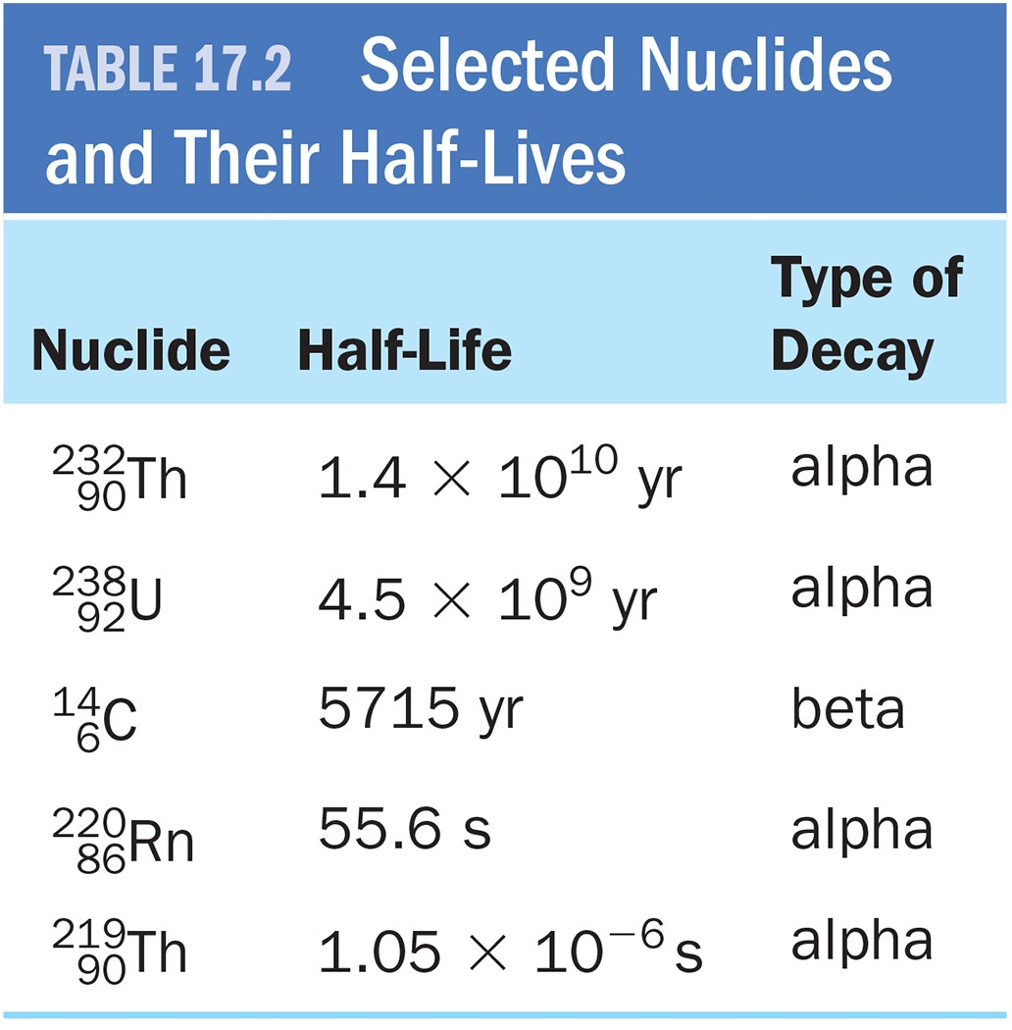
Half-lives of Radium Nuclides
Ex Probs

Slide 22
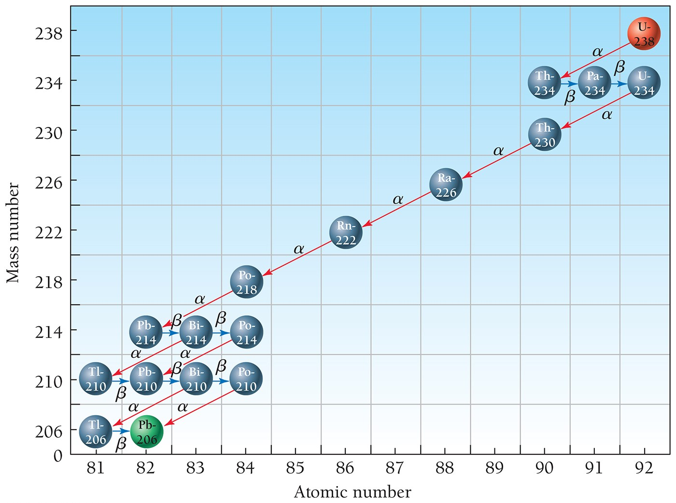
U-238 Decay Series
In many cases, daughter nuclides are also radioactive.

Slide 23
Application: Radiocarbon Dating (C-14 Dating)
C H
N
14
7
N
+
1
0
n
14
6
+
1
1
C-14 Made
14
6
C
0
-1
e
14
7
+
C-14 Broken down
Half-life of ¹⁴C = 5715 years
Atmosphere has constant amount of ¹⁴C.
¹⁴C content in a living plant is constant due to constant uptake of ¹⁴CO₂ by plant.
At moment of death, plant ¹⁴C decays without replenishment.
So ¹⁴C content of fossil tells how much time has
passed since the plant died (age).

Slide 24
Effect of Radiation on Life

Slide 25
Damaging Effects of Radiation
Ionizing power: ability of radiation to ionize molecules and atoms. More massive particles have more potential to interact with and ionize other molecules.
Penetrating power: ability of radiation to penetrate matter. Smaller particles can penetrate more deeply.

Slide 26
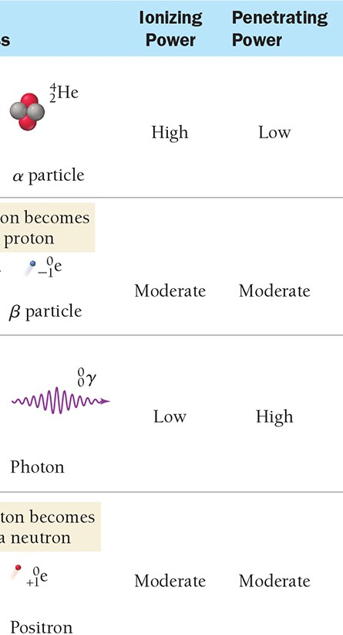
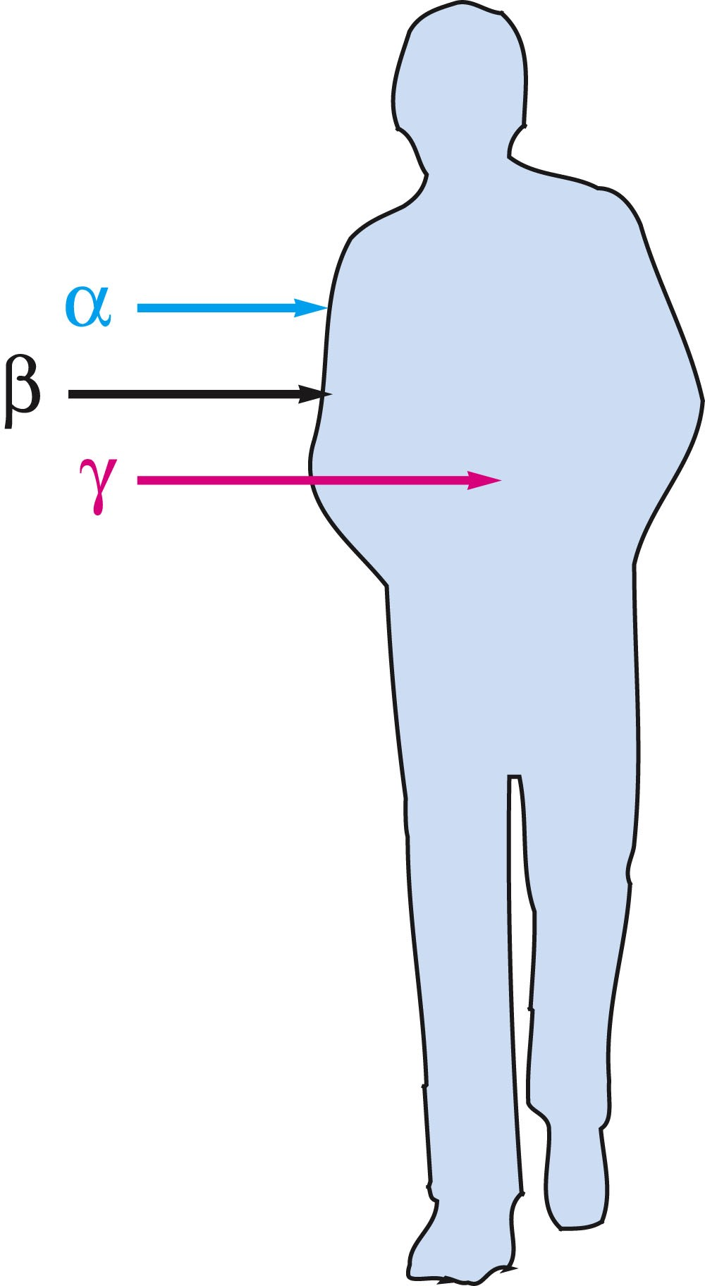
Effects of Different Types of Radiation
Stopped By
Sheet of paper, clothing
Sheet of metal, thick wood
Thick lead or concrete
γ ray
Sheet of metal, thick wood (also for gamma ray)

Slide 27
Types of Radiation Damages
Acute radiation damage: damage to cells resulting from exposures to large amounts of radiation in short period of time
Increased cancer risk: Lower radiation doses over a longer period of time can cause damage to somatic cells and increase cancer risk.
Genetic defects: damage to DNA in reproductive cells that shows eﬀect in oﬀspring

Slide 28
Effects of Short-Term Radiation Exposure
Rem: A unit that indicates biological damage of radiation

Slide 29
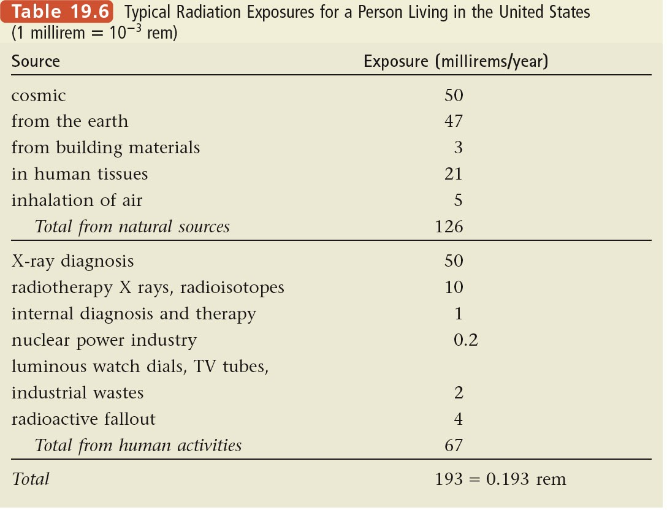
Biological Effects of Radiation
Typical Radiation Exposure in U.S.

Slide 30
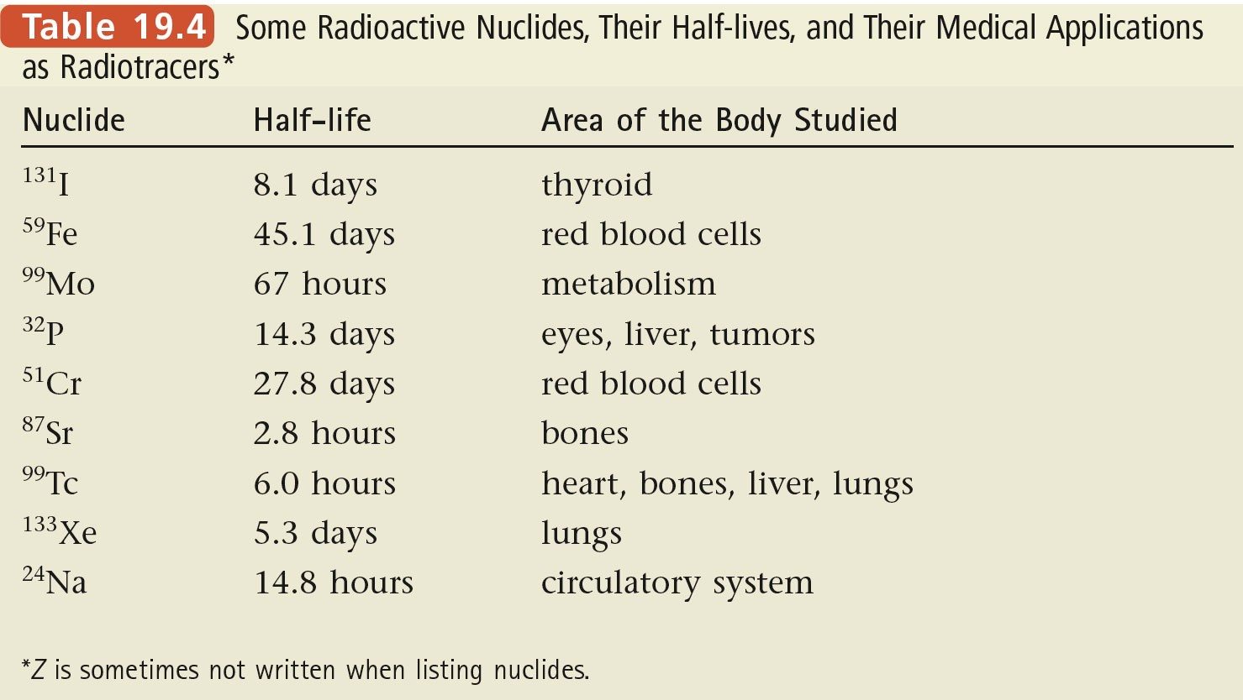
Nuclear Medicine Application: Radiotracers
Radiotracers: radioactive nuclides that can be put into organisms through food or drugs, and be traced for medical diagnostics

Slide 31
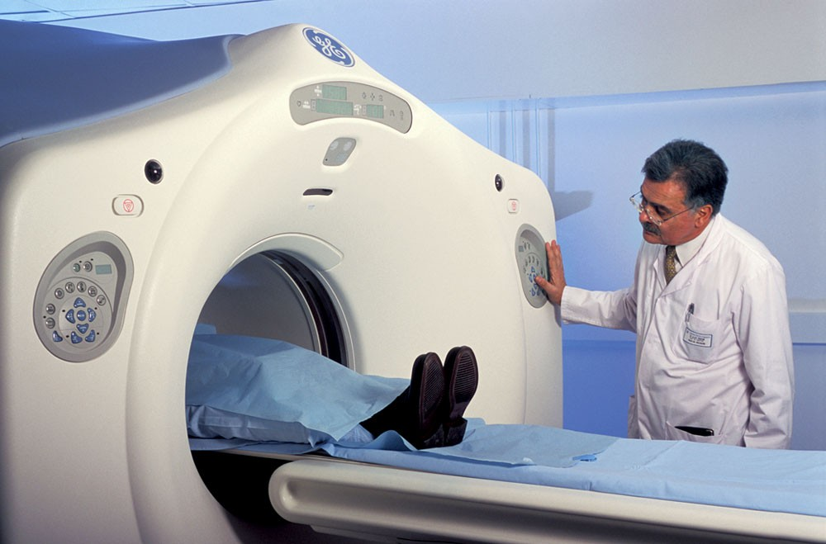
Radiotracers in PET Scans
PET: positron emission tomography
Examples of positron-producing isotopes: ¹⁸F, 11_{C}
These radioactive isotopes are attached to glucose.
Areas of brain rapidly consuming these radiotracers “light up” on PET screen.
Short half-lives (110 min for ¹⁸F, 20 min for ¹¹C) require speedy synthesis.

Slide 32
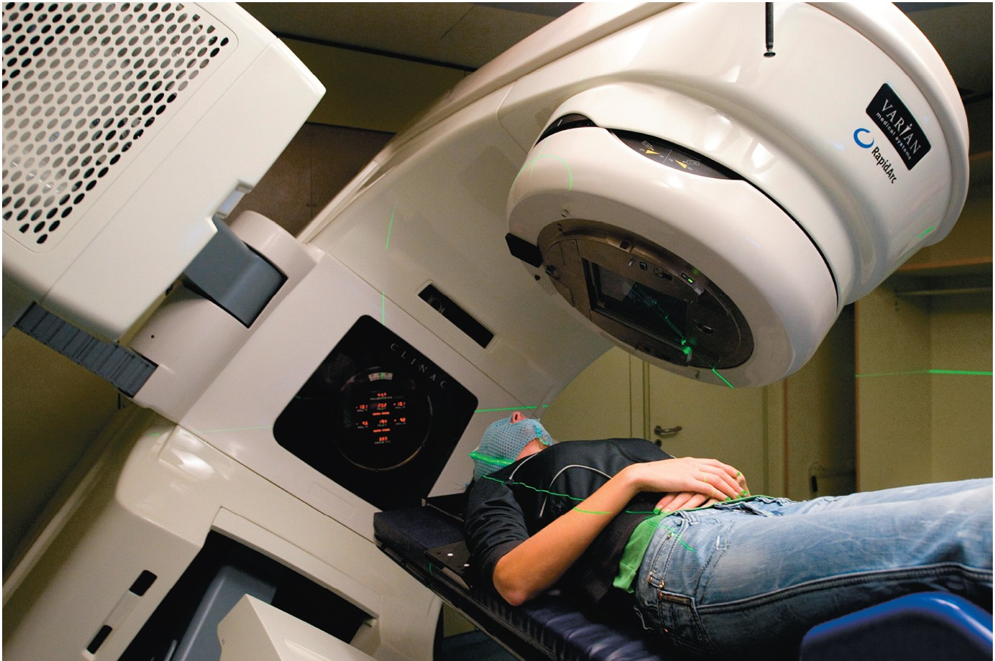
Nuclear Medicine Application: Radiotherapy
Gamma rays are used to kill rapidly dividing cancer cells.
Patients undergoing radiotherapy develop symptoms of radiation sickness (vomiting, hair loss, skin burns).

